Slide 1

Parkinson’s Disease
Brain Data Processing & Analyzing
August 2023
UNIST
Yeji Kim

Slide 2

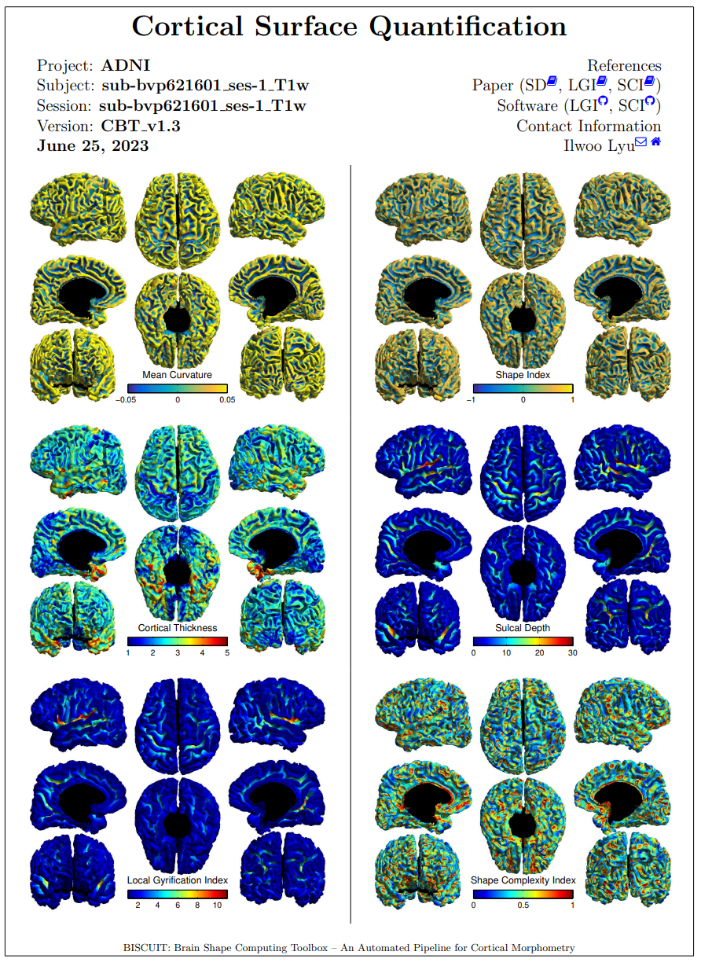
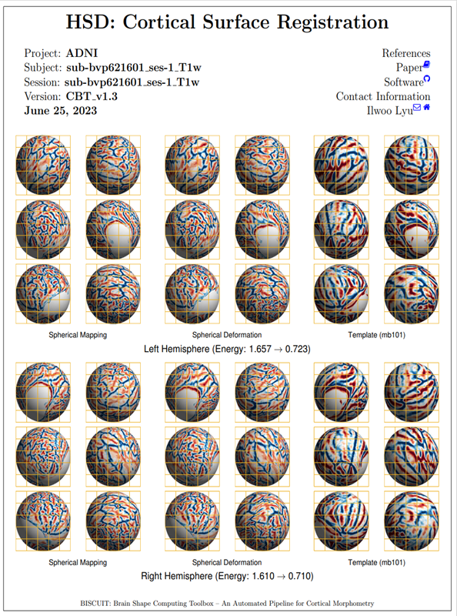
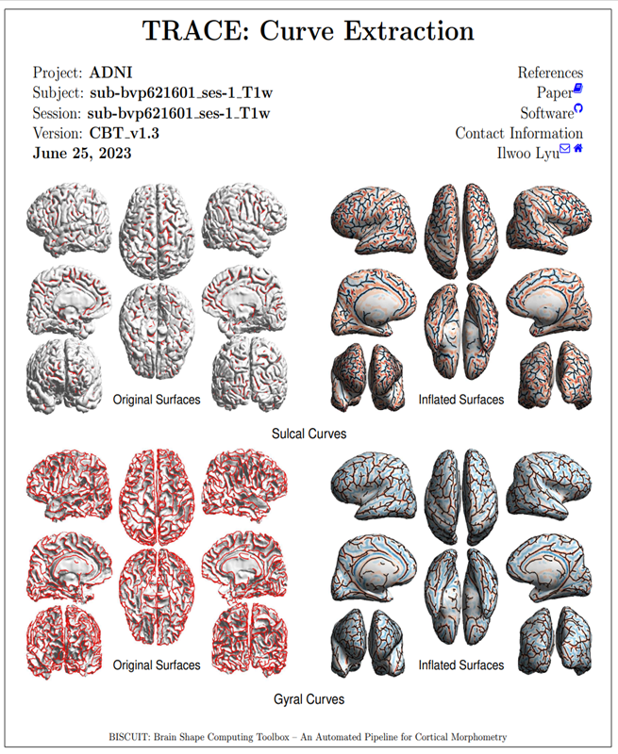
Cohorts
Data
64 T1 scans (50 subjects)
CONTROL : 27 T1 scans (21 subjects)
BVP : 19 T1 scans (19 subjects)
UVP : 18 T1 scans (10 subjects)
Cortical surface reconstruction and registration
FreeSurfer¹⁾
HSD²⁾
QA
63/64 good QA (1 questionable QA)
1) freesurfer: Fischl, Neuroimage 62.2 (2012)
2) Lyu, Ilwoo, et al. Medical image analysis 57 (2019)

Slide 3
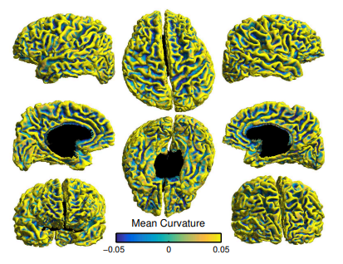
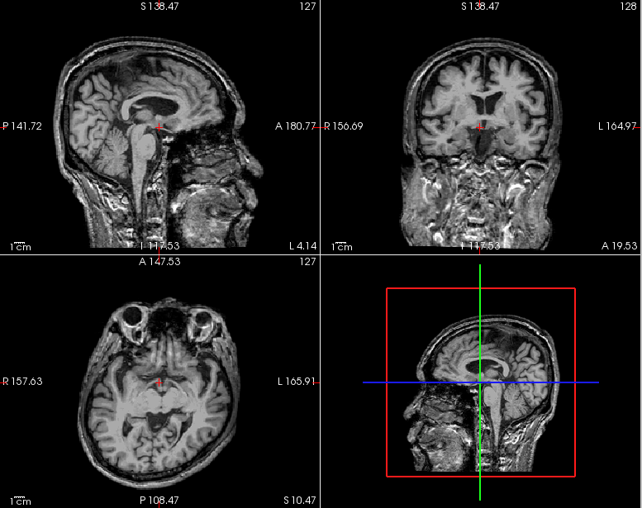
Questionable QA
Data
Session : sub-bvp9901808 ses-1 T1w
<Cortical Surface Quantification>
<MRI>

Slide 4
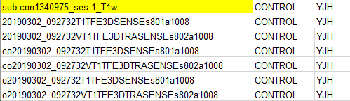
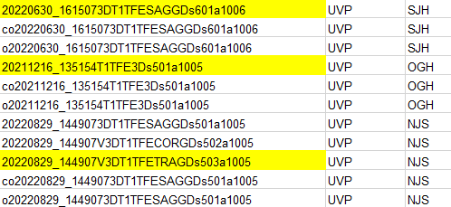
Cohorts
Utilized Data
Used 50 independent subjects (60 scans)
14 subjects with multi-scanned data were excluded
CONTROL : 21 scans
BVP : 19 scans
UVP : 10 scans

Slide 5
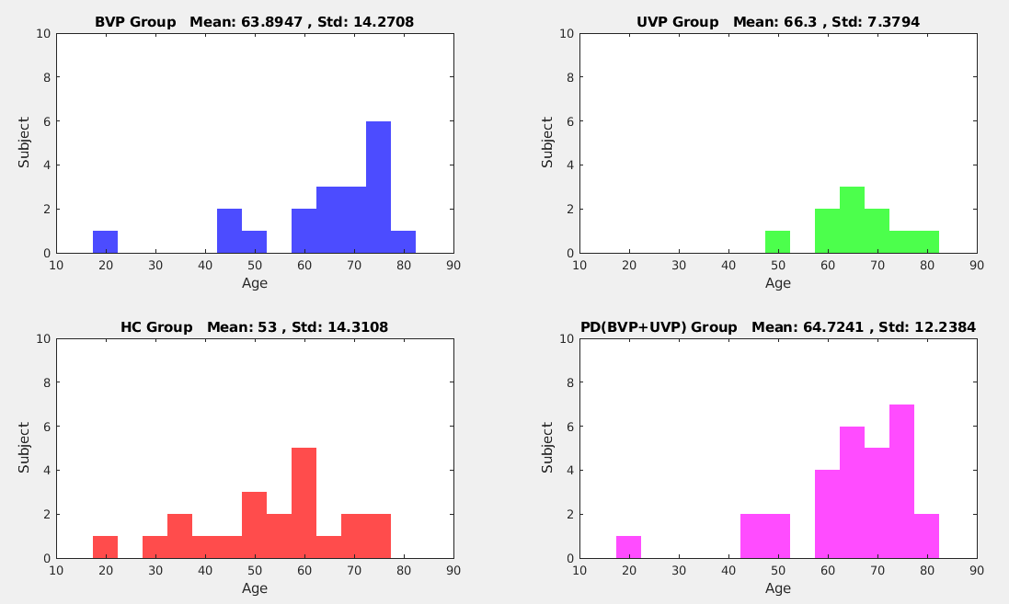
Cohorts Statistics

Slide 6
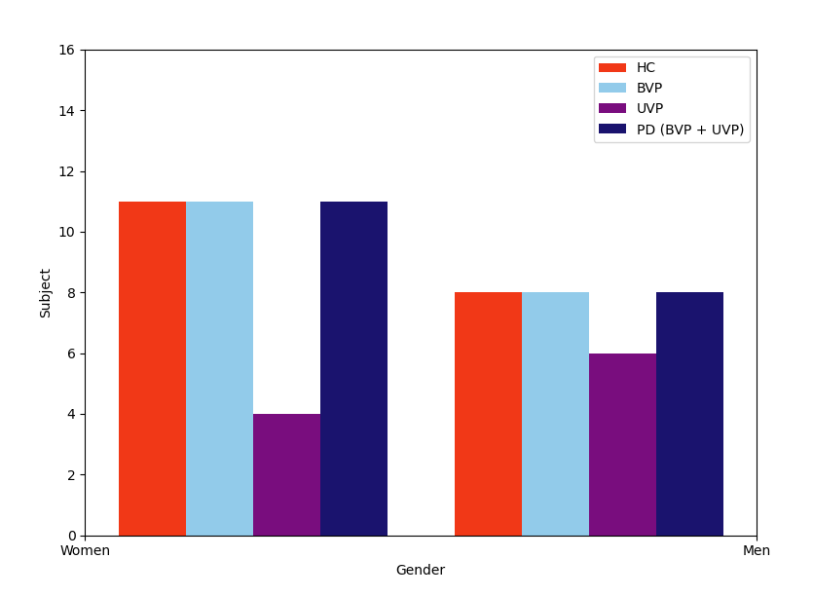
Cohorts Statistics

Slide 7
Processing
Cortical measures
Cortical thickness, sulcal depth¹⁾, and local gyrification index²⁾
Statistical model (SurfStat, Worsley)
Measures = 1 + {HC,PD} + Gender + Age
Multi-comparision correction
Corrected p=0.05 (RFT), cluster threshold (raw p) = 0.01
1) Lyu, Ilwoo, et al. Medical Imaging 2018: image processing.
2) Lyu, Ilwoo, et al. Medical image analysis 48 (2018)

Slide 8
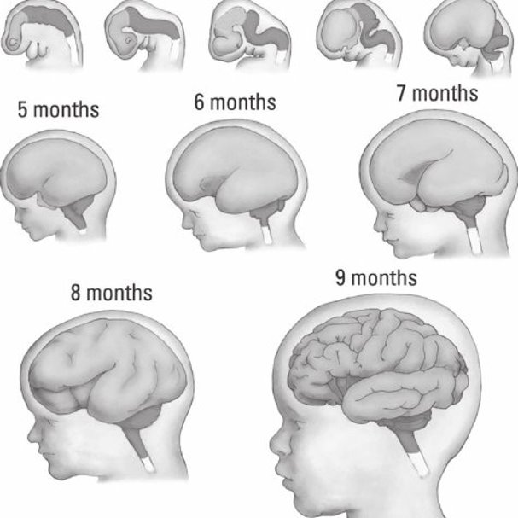
Prenatal Brain Development
Gyrification
From a simple form to highly convoluted structure over time even before birth

Slide 9
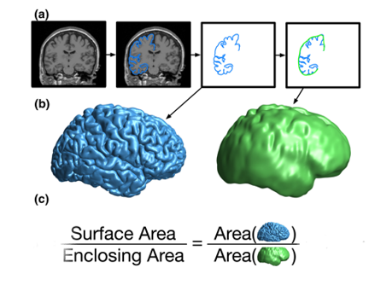
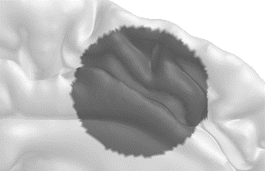
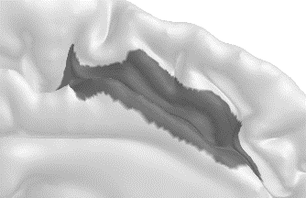
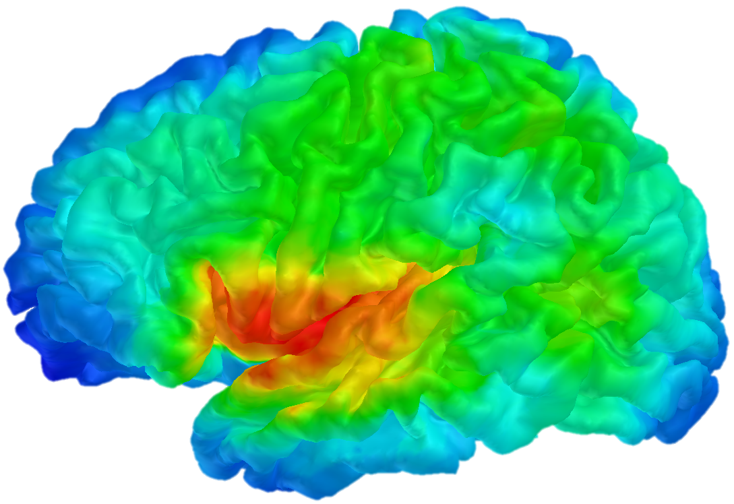
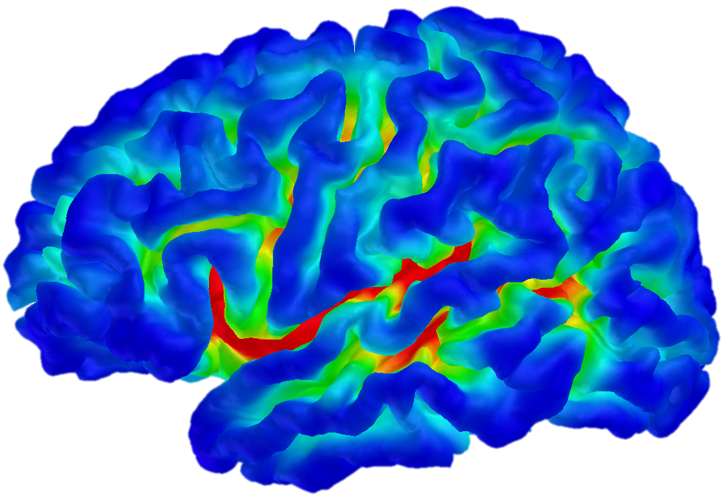
Sulcal Depth & Gyrification Index
Measures
Sulcal depth : distance from cerebral hull to pial surface
Local gyrification index(LGI) : area ratio between cerebral hull and pial surface
Complementary measures
Sulcal depth increases : gyrification index increases
Sulcal width increases : gyrification index decreases

Slide 10
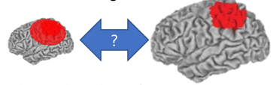
Gyrification Index
Issues in studies using LGI
Large kernel : r => 25 mm
Unadjusted kernel size : Inconsistent results for same shapes at different scales

Slide 11
Analysis
HC (Healthy Control), PD (Parkinson Disease)
 | thickness | sd | lgi
HC > PD | x | x | x
HC < PD | x | o | x
HC (Healthy Control), UVP
 | thickness | sd | lgi
HC > UVP | x | o | o
HC < UVP | x | o | x

Slide 12
HC & PD

Slide 13
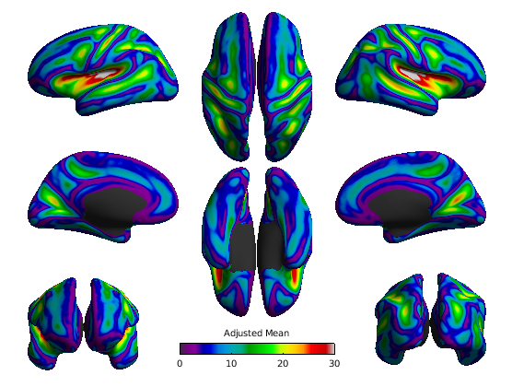
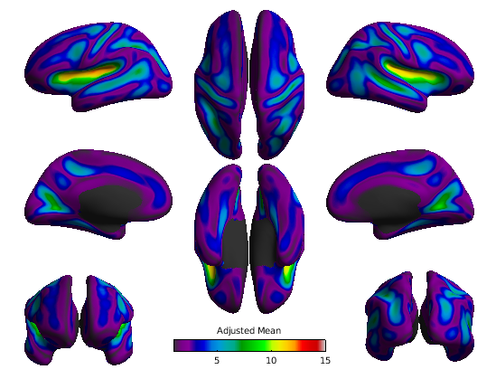
Sulcal Depth and Gyrification Index
Sulcal Depth
Gyrification Index

Slide 14
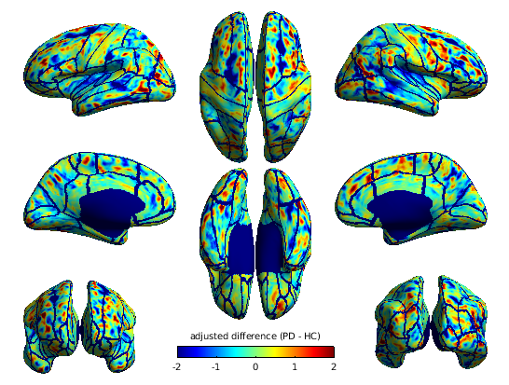
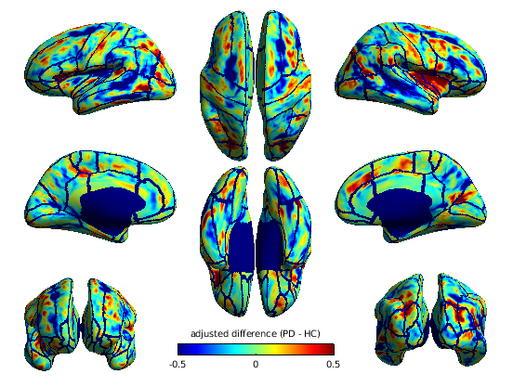
Sulcal Depth and Gyrification Index(HC < PD)
Sulcal Depth
Gyrification Index

Slide 15

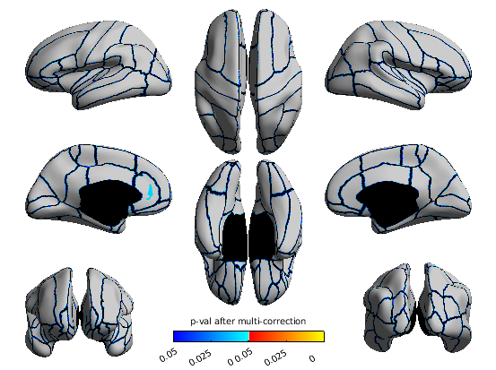


Sulcal Depth and Gyrification Index(HC < PD)
Both width and depth change (no change in LGI for same shape with different scale)
Sulcal Depth
Gyrification Index

Slide 16
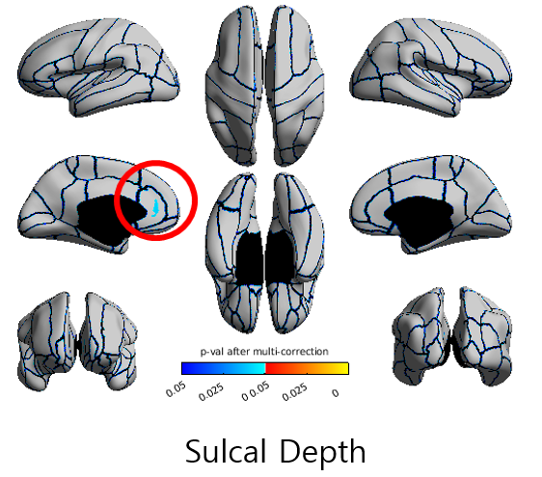
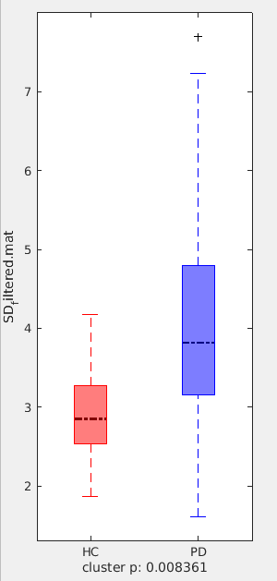
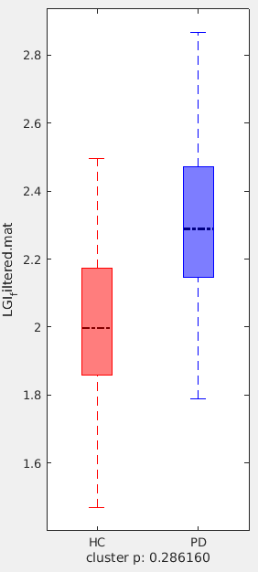
Sulcal Depth and Gyrification Index(HC < PD)
Sulcal Depth
Gyrification Index

Slide 17
Sulcal Depth and Gyrification Index(HC < PD)
Once a diagnosis of Parkinson's disease (PD) has been made, cognitive impairment has begun and involves anterior cingulate cortex (ACC).
Vogt BA. Cingulate cortex in Parkinson's disease. Handb Clin Neurol. 2019;166:253-266. doi: 10.1016/B978-0-444-64196-0.00013-3. PMID: 31731914.
Sulcal Depth

Slide 18
HC & UVP

Slide 19
Analysis
HC (Healthy Control), UVP
 | thickness | sd | lgi
HC > UVP | x | o | o
HC < UVP | x | o | x

Slide 20
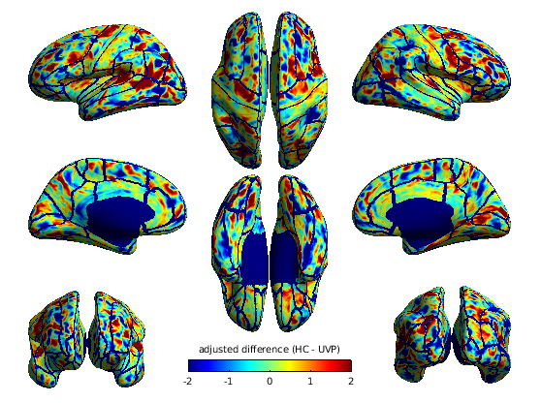
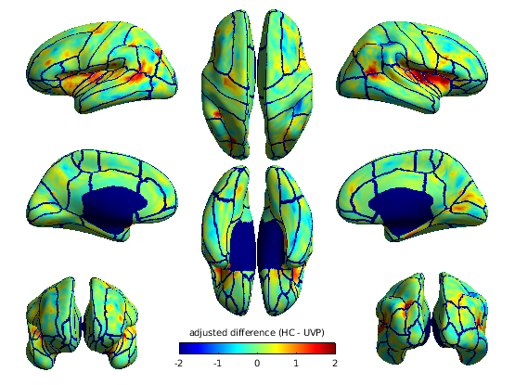
Sulcal Depth and Gyrification Index (HC > UVP)
Sulcal Depth
Gyrification Index

Slide 21

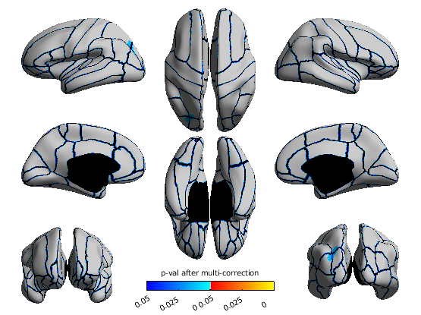
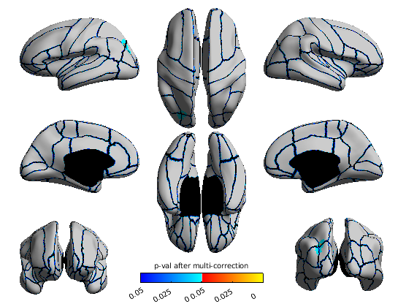
Sulcal Depth and Gyrification Index (HC > UVP)
Depth difference
Intraparietal sulcus
Sulcal Depth
Gyrification Index

Slide 22
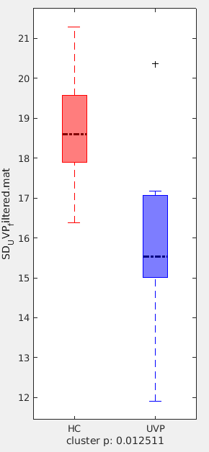
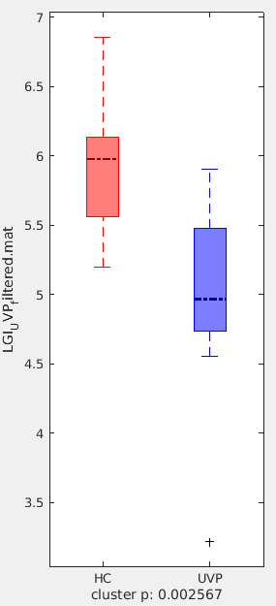
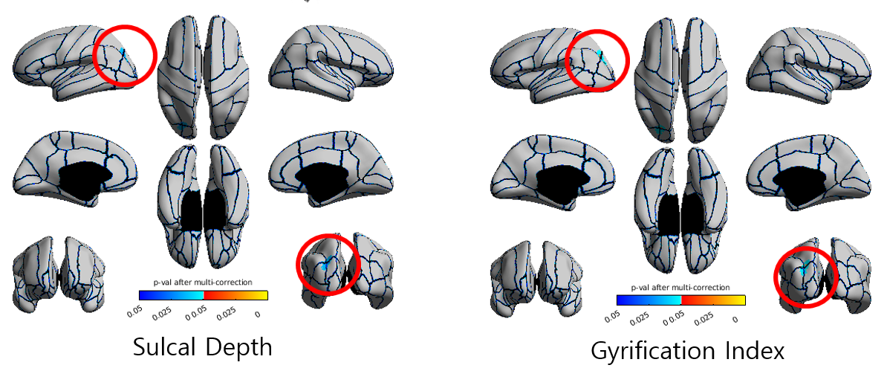
Sulcal Depth and Gyrification Index (HC > UVP)
Sulcal Depth
Gyrification Index

Slide 23
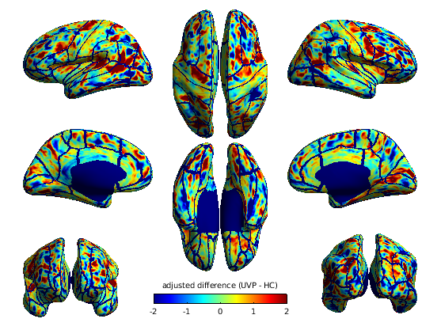
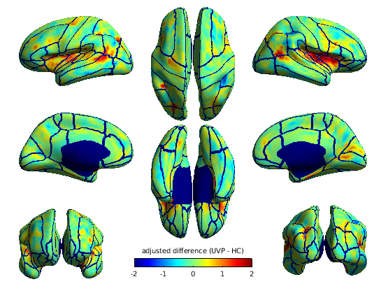
Sulcal Depth and Gyrification Index (HC < UVP)
Sulcal Depth
Gyrification Index

Slide 24
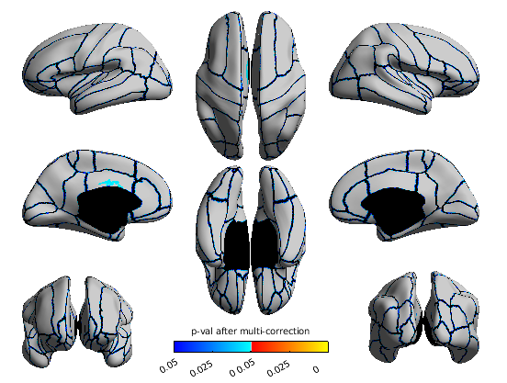

Sulcal Depth and Gyrification Index (HC < UVP)
Both width and depth change (no change in LGI for same shape with different scale)
Sulcal Depth
Gyrification Index

Slide 25
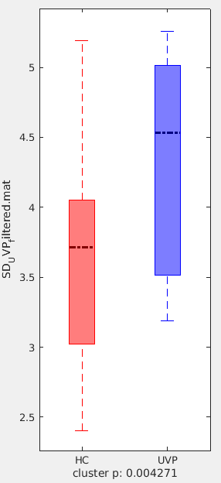
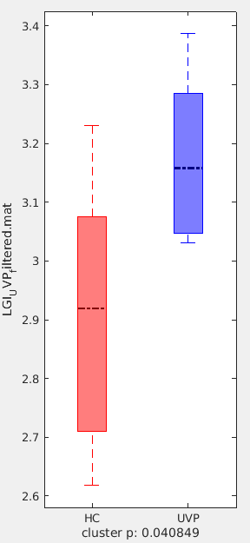
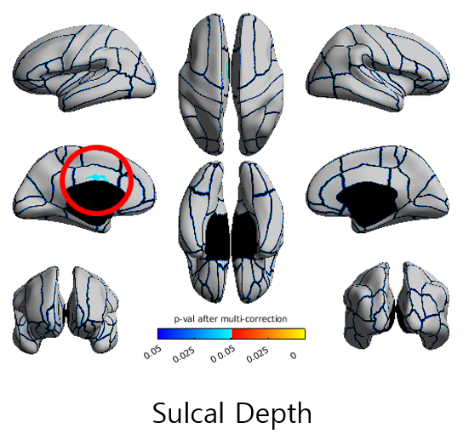
Sulcal Depth and Gyrification Index (HC < UVP)
Sulcal Depth
Gyrification Index

Slide 26
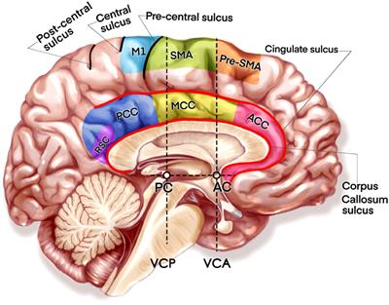
Sulcal Depth and Gyrification Index (HC < UVP)
Depressive symptoms are common in Parkinson's disease (PD)
Compared with the NDPD(Non-Depressed PD patients) and HC, the DPD(Depressed PD patients) group showed significantly increased ALFF(Amplitude of Low Frequency Fluctuations) in the left median cingulated cortex (MCC)
Hu X, Song X, Li E, Liu J, Yuan Y, Liu W, Liu Y. Altered Resting-State Brain Activity and Connectivity in Depressed Parkinson's Disease. PLoS One. 2015 Jul 6;10(7):e0131133. doi: 10.1371/journal.pone.0131133. PMID: 26147571; PMCID: PMC4492789.
Sulcal Depth

